Slide 1

(Basic) Introduction to (H)DDM
Now with a taste of HSSM!
Theoretical and applied concepts
Sean Devine
[seandamiandevine@gmail.com]

Slide 2
Plan
Quickly introduce the DDM conceptually
Discuss why you might want to fit a DDM
Describe HDDM (Wiecki et al., 2013)
Criminally short intro to Bayesian statistics
Describe an Example dataset
Fit some HDDMs
Basic HDDM
Grouped HDDM
HDDM Regressions
Touch on HSSM

Slide 3
Goals
Gain an understanding of what a DDM is and why you need one
Have some idea about how one of the ways you would go about fitting and interpreting DDM parameters
Have fun ☺

Slide 4
Not the goals
Understand the deep mechanics of drift diffusion modeling
Clearly grasp concepts of Bayesian statistics and analysis
Code like a Python pro
Understanding everything

Slide 5
What is the DDM?
Models the joint distribution of response time (RT) and binary responses (0,1)
Decomposes these dependent variables into independent parameters that are psychologically interpretable
Assumes decisions arise as a noisy evidence accumulation process

Slide 6
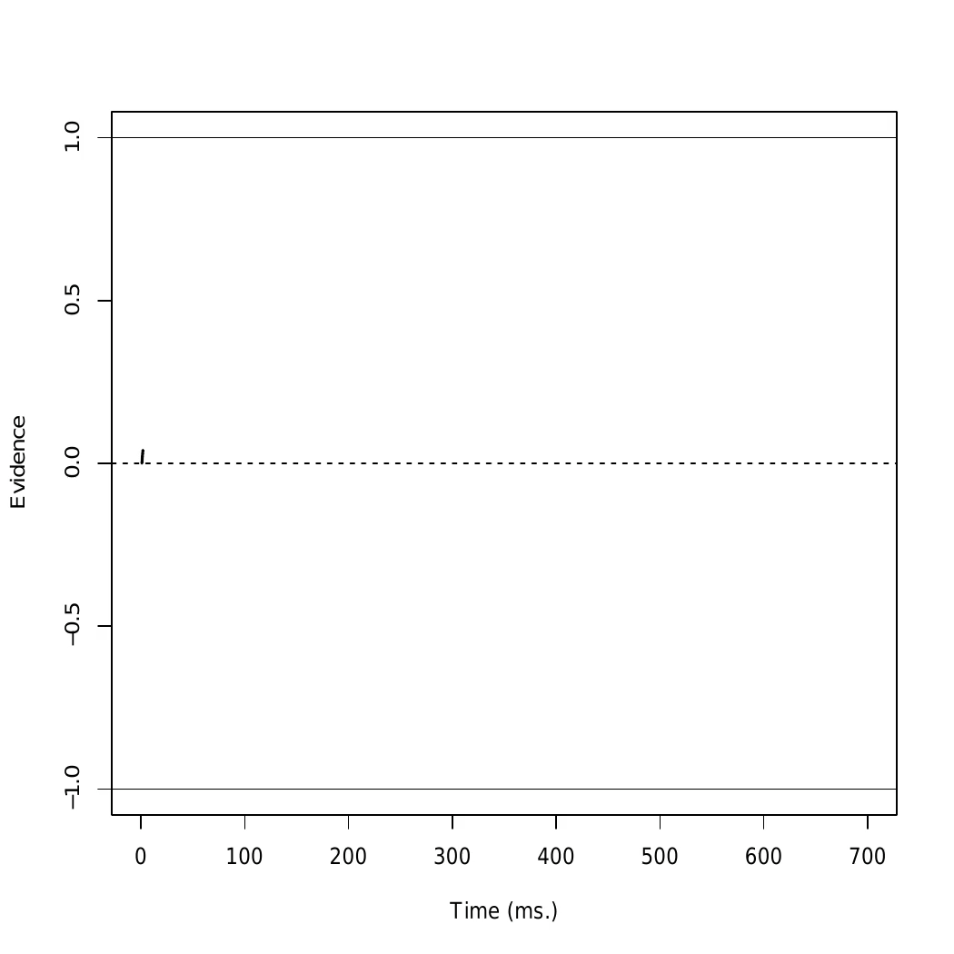

What is the DDM?
Yes
Is this dot blue?
RT = Time + Some Motor Time
No

Slide 7


Why use a DDM?
Example:
John
Jane
Mean RT = 450ms
Accuracy = 87%
Mean RT = 560ms
Accuracy = 90%

Slide 8
Why use a DDM?
Example:
John
Jane
Mean RT = 450ms
Accuracy = 87%
Mean RT = 560ms
Accuracy = 90%
Who did better?
Who worked harder?
Why was Jane slower than John?

Slide 9
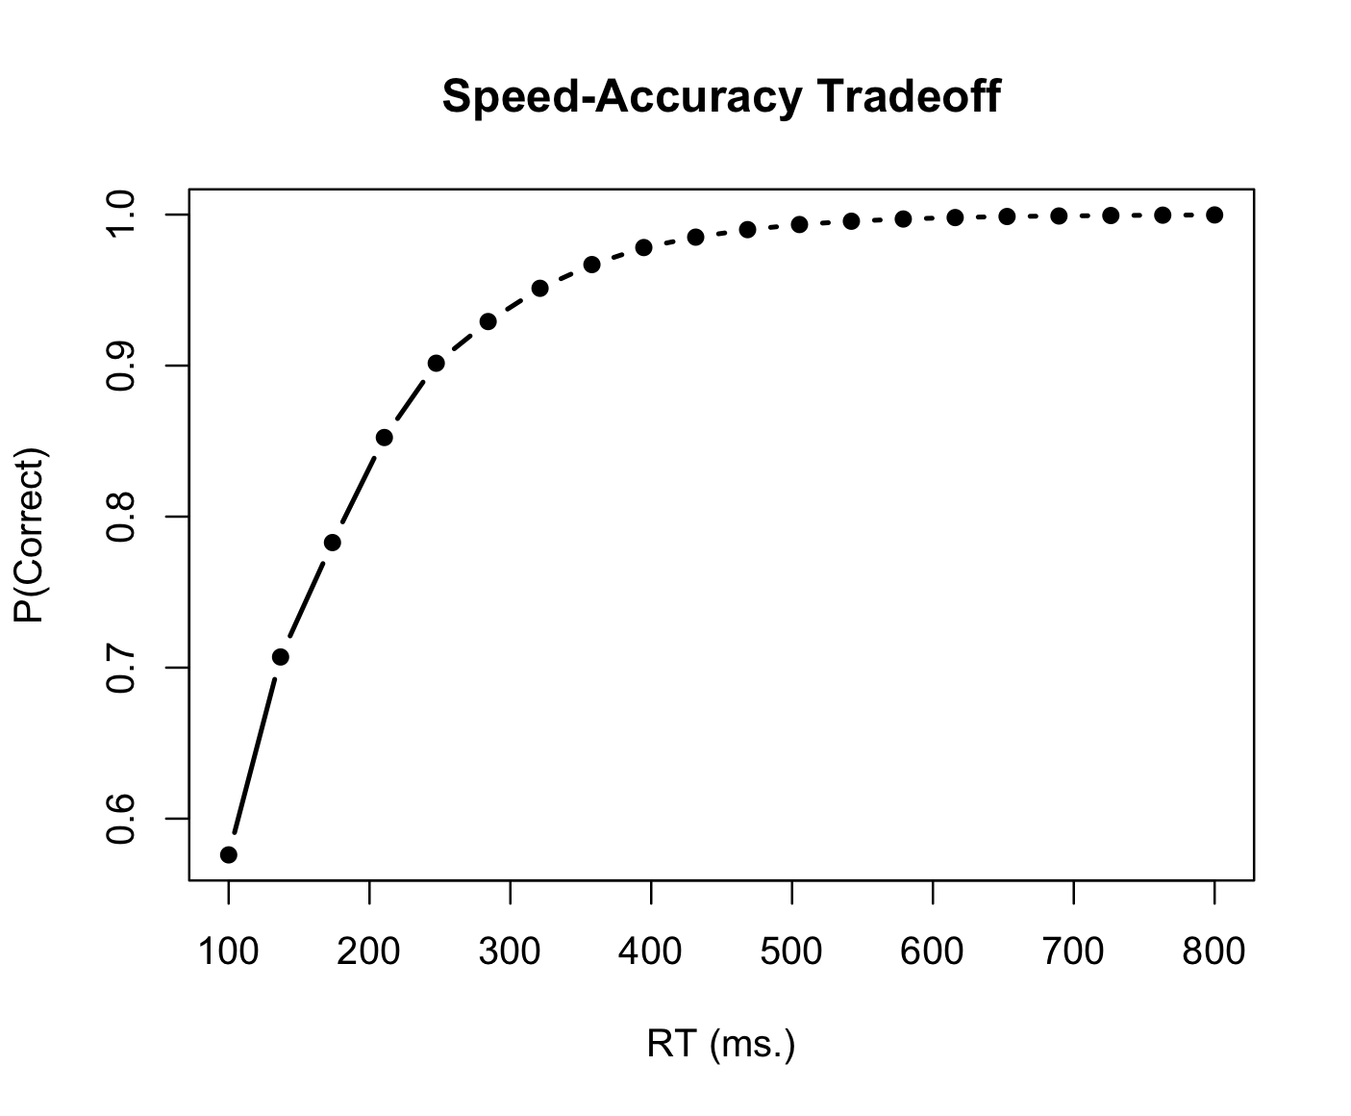
Why use a DDM?
- More formally

Slide 10
Why use a DDM?
- More formally
How can we know why someone is slower?
Inattention?
Capacity limitations?
Caution/deliberation?

Slide 11
Why use a DDM?
- More formally
The DDM quantifies these interpretation in parameter values
Specifically, the DDM has four main parameters
Decision threshold (a)
Drift Rate (v)
Starting Point (z)
Non-Decision Time (t)

Slide 12
DDM parameters
Example values:
a = 1
v = -0.9
z = 0
t = 100
Correct/Response 1
a = decision boundary
v = drift rate
z = starting point
t = non-decision time
t
a
z
v
Incorrect/Response 2

Slide 13
DDM parameters
Example values:
a = 0.7
v = -0.9
z = 0
t = 100
Correct/Response 1
a = decision boundary
v = drift rate
z = starting point
t = non-decision time
t
a (narrower)
z
v
Incorrect/Response 2
Behaviourally:
Fast RTs, more “errors”

Slide 14
DDM parameters
Example values:
a = 1
v = -1.5
z = 0
t = 100
Correct/Response 1
a = decision boundary
v = drift rate
z = starting point
t = non-decision time
t
a
z
v (stronger)
Incorrect/Response 2
Behaviourally:
Fast RTs, less “errors”

Slide 15
DDM parameters
Example values:
a = 1
v = -0.9
z = -0.2
t = 100
Correct/Response 1
a = decision boundary
v = drift rate
z = starting point
t = non-decision time
t
a
z (biased)
v
Incorrect/Response 2
Behaviourally:
Fast RTs for one response
Slow RTs for the other

Slide 16
DDM parameters
Example values:
a = 1
v = -0.9
z = 0
t = 200
Correct/Response 1
a = decision boundary
v = drift rate
z = starting point
t = non-decision time
t (longer)
a
z
v
Incorrect/Response 2
Behaviourally:
Slow RT, same responses

Slide 17

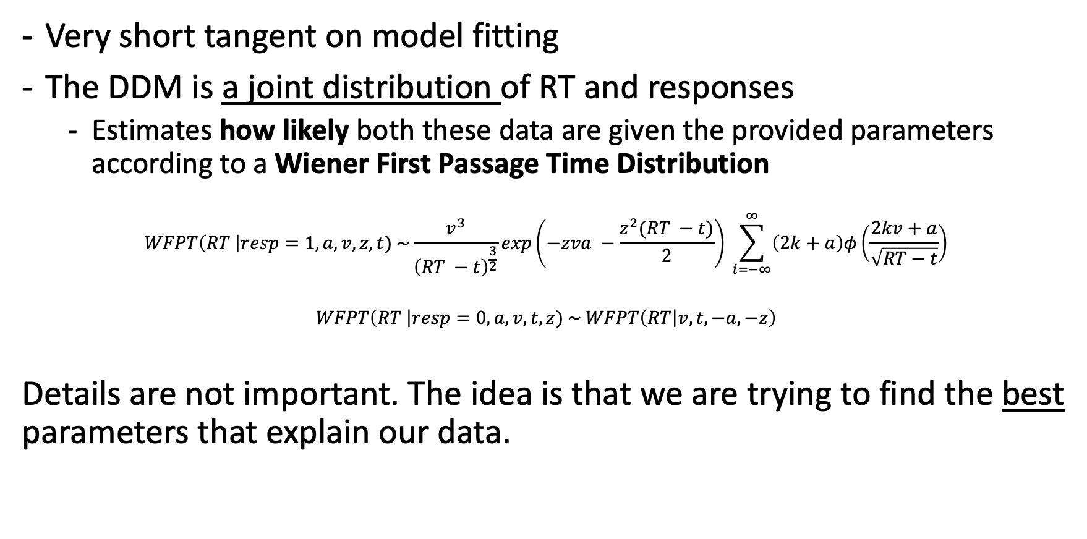
Fitting a DDM
Statistics Alert!
Very short tangent on model fitting
The DDM is a joint distribution of RT and responses
Estimates how likely both these data are given the provided parameters according to a Wiener First Passage Time Distribution
$$WFPT\left(RT \right|resp=1, a,v,z,t) \sim \frac{v^{3}}{{\left(RT −t\right)}^{\frac{3}{2}}}exp\left(−zva −\frac{z^{2}(RT −t)}{2}\right) \sum_{i=−∞}^{∞}{\left(2k+a\right)φ\left(\frac{2kv+a}{\sqrt{RT−t}}\right)}$$
$$WFPT\left(RT \right|resp=0,a,v,t,z) \sim WFPT\left(RT | v,t,−a,−z\right)$$
Details are not important. The idea is that we are trying to find the best parameters that explain our data.

Slide 18
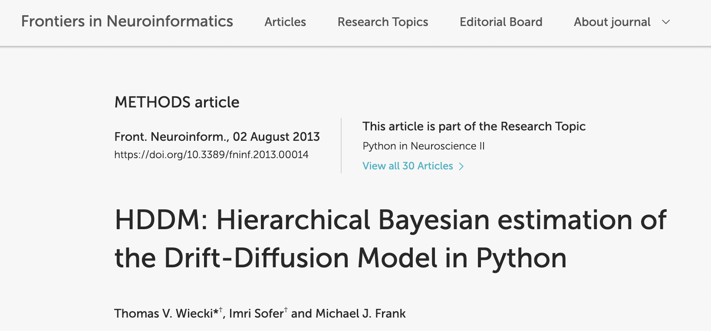
Fitting a DDM
In practice, we don’t have to worry about these statistical concepts, because we can use pre-made packages that estimate a DDM for us.
HDDM (Wiecki et al., 2013)
Package that estimates drift diffusion models in Python using a hierarchical and Bayesian approach
Finding the right parameters for the WFTP (a,v,z,t) is known as fitting a model

Slide 19
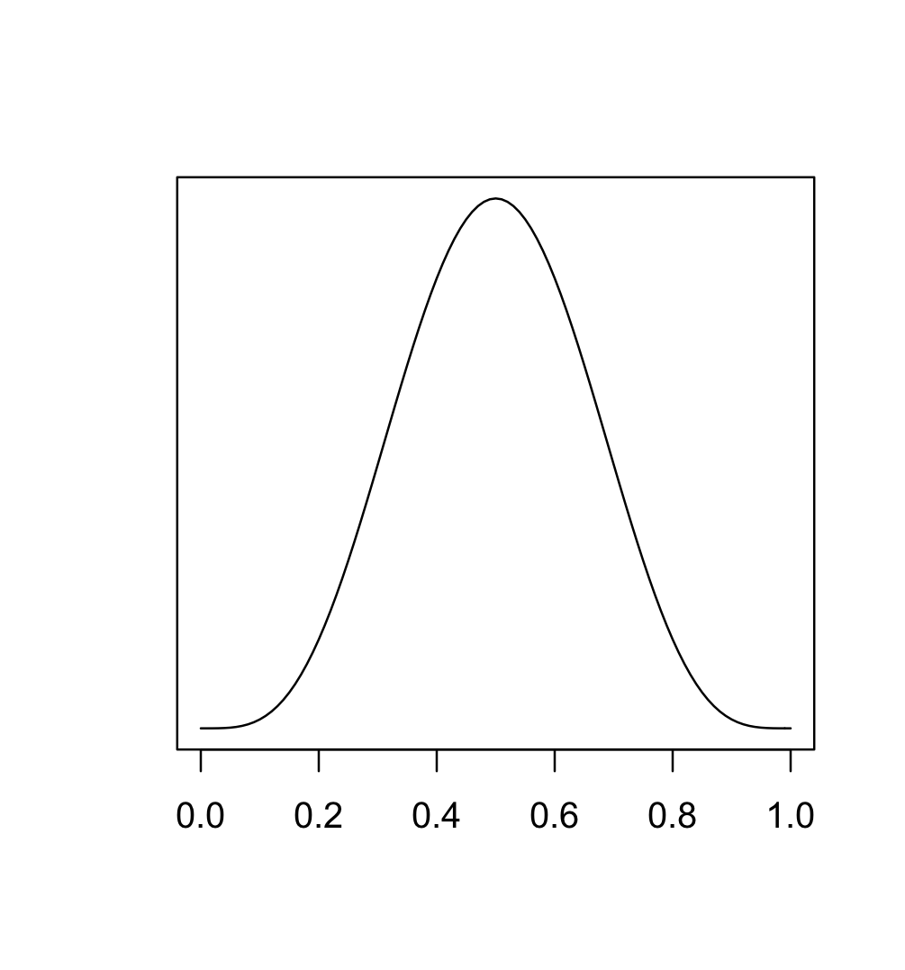
Fitting a DDM
- HDDM (Wiecki et al., 2013)
Package that estimates drift diffusion models in Python using a hierarchical and Bayesian approach
Hierarchical: Assumes each subject’s parameters come from a group-level distribution of parameters
Group-average a
Subject level variance

Slide 20
Fitting a DDM
- HDDM (Wiecki et al., 2013)
Package that estimates drift diffusion models in Python using a hierarchical and Bayesian approach
Hierarchical: Assumes each subject’s parameters come from a group-level distribution of parameters
Group-average a
Subject A here
Subject level variance
Subject B here

Slide 21
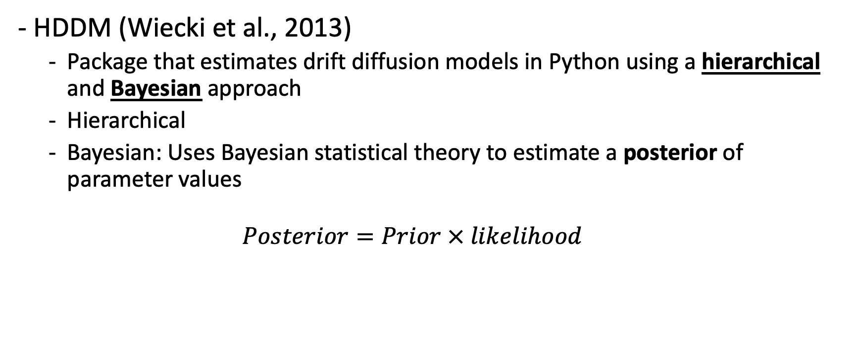
Fitting a DDM
- HDDM (Wiecki et al., 2013)
Package that estimates drift diffusion models in Python using a hierarchical and Bayesian approach
Hierarchical
Bayesian: Uses Bayesian statistical theory to estimate a posterior of parameter values
$$Posterior=Prior × likelihood$$

Slide 22
Fitting a DDM
- HDDM (Wiecki et al., 2013)
Package that estimates drift diffusion models in Python using a hierarchical and Bayesian approach
Hierarchical
Bayesian: Uses Bayesian statistical theory to estimate a posterior of parameter values
$$Posterior=Prior × likelihood$$
Prior = Prior belief about a parameter’s value (before looking at the data)
“On average, people preferred the right item in my experiment, so the drift rate is probably positive”
These are set by default by HDDM, so not much need to worry about this in the basic case

Slide 23
Fitting a DDM
- HDDM (Wiecki et al., 2013)
Package that estimates drift diffusion models in Python using a hierarchical and Bayesian approach
Hierarchical
Bayesian: Uses Bayesian statistical theory to estimate a posterior of parameter values
$$Posterior=Prior × likelihood$$
Likelihood = How likely are the data given the parameter values
”If my parameters are a = 1, v = .9, z = 0.5, t = 100, how likely is it that I would observe the data I have?”

Slide 24
Fitting a DDM
- HDDM (Wiecki et al., 2013)
Package that estimates drift diffusion models in Python using a hierarchical and Bayesian approach
Hierarchical
Bayesian: Uses Bayesian statistical theory to estimate a posterior of parameter values
$$Posterior=Prior × likelihood$$
Posterior = Combination of Prior beliefs with likelihood of data
This is always a distribution, not a number.
This means that you will compute statistics over a distribution of possible parameter values.
We will see how to interpret this with an example

Slide 25
Fitting a DDM
- HDDM (Wiecki et al., 2013)
Package that estimates drift diffusion models in Python using a hierarchical and Bayesian approach
Hierarchical
Bayesian: Uses Bayesian statistical theory to estimate a posterior of parameter values
For a tutorial: https://docs.google.com/presentation/d/1afr2XI4Abv5eoZLZ5KhyKB8F9f_uXMHal8UhlBxNRqI/edit?usp=sharing

Slide 26
Let’s get fittin’!

Slide 27
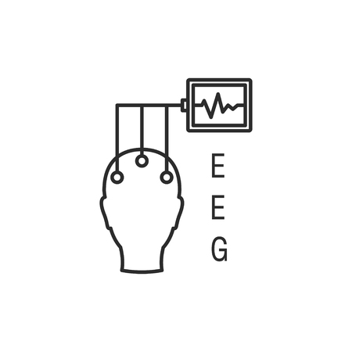


Toy example: Preference task
+
N = 10
100 trials each
5 PD, 5 HC

Slide 28
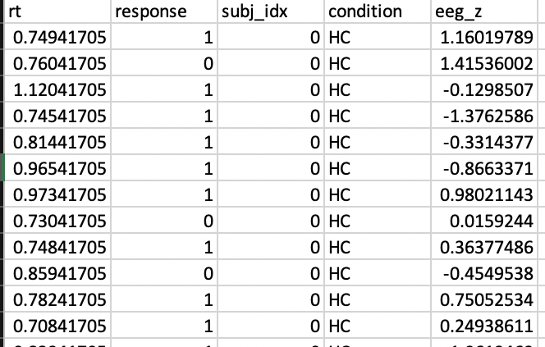
Data example
Toy data set:
rt: trial by trial reaction time (in seconds)
response: trial by trial choice (1 = right option, 0 = left option)
subj_idx: subject number (0-9)
condition: Parkinson’s (PD) or Healthy Control (HC)
eeg_z: standardized summary eeg signal on that trial

Slide 29


Analysis environment
Analysis done using Python
Data manipulation done with pandas
Visualization done with matplotlib
Note:
A whole course could be taught on data analysis and Python
I will include code snippets throughout, but the goal is not to understand the syntax, but just to follow the steps that I’m doing. The rest can come later.
If you get lost, ask questions!

Slide 30
HDDMs
Three types of HDDM, of increasing complexity:
Basic HDDM (very fast; minutes-hours)
Conditional HDDM (still fast, but slower than HDDM, hours-days)
HDDMRegressor (slow, but informative for W.S. designs, hours-days+)

Slide 31
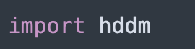
1. Import HDDM
To install HDDM, you have can use pip or anaconda, but it’s a little temperamental.
Follow these steps for best results:
https://huchuanpeng.com/post/2019-04-29-how-to-install-and-use-hddm/

Slide 32
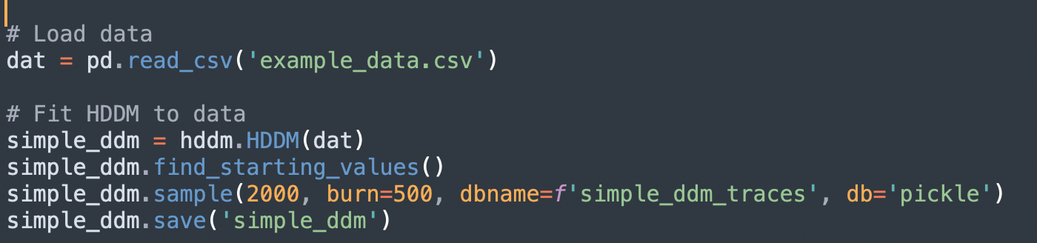
2: Fit basic HDDM
This will fit a model that estimates:
Overall parameter posteriors for the sample
Subject-specific parameter posterios

Slide 33
2: Fit basic HDDM
Loads data from csv file

Slide 34
2: Fit basic HDDM
Initializes, but does not fit, the DDM
Note:
Data must at least have the following columns to fit an HDDM
rt (lower case, in seconds)
response (lower case, 0 or 1)
subj_idx (lower case, can be anything)

Slide 35
2: Fit basic HDDM
Finds starting values for the optimization process
Not strictly necessary, but can improve estimates

Slide 36
2: Fit basic HDDM
“Samples” from the posterior (dbname and db save these samples to a file for later use)
This requires a bit of background in Bayesian stats. Again, just try to get the idea, not the math

Slide 37
Quick digression about MCMC sampling
“Walk around” the parameter space and look for parameters that fit best
Process of trial-and-error that converges, eventually, on the correct parameters
It’s a numbers game!
The first few guesses will be bad, so we discard those as “burn-in”
We keep that last guesses and try to have enough of them to draw meaningful conclusions
More is better, but takes more time.

Slide 38
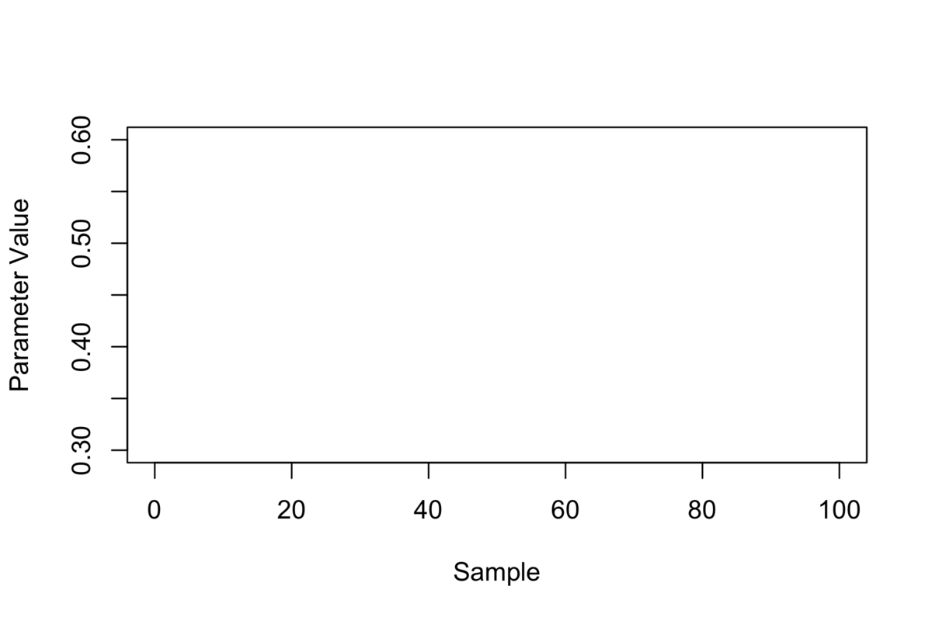
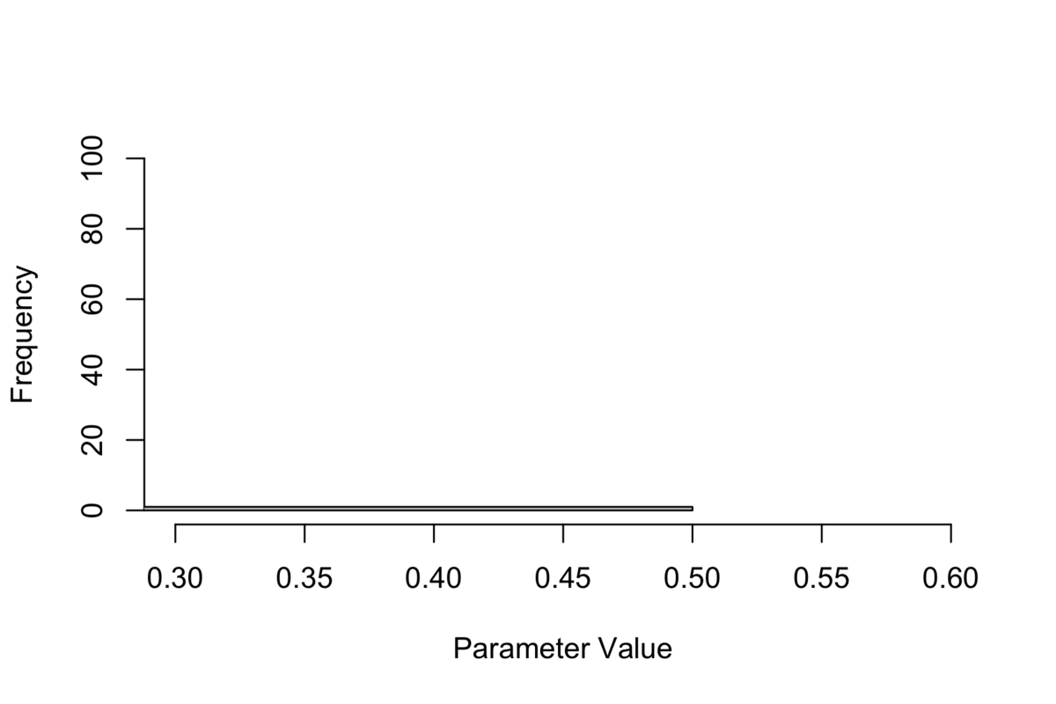
Quick digression about MCMC sampling

Slide 39
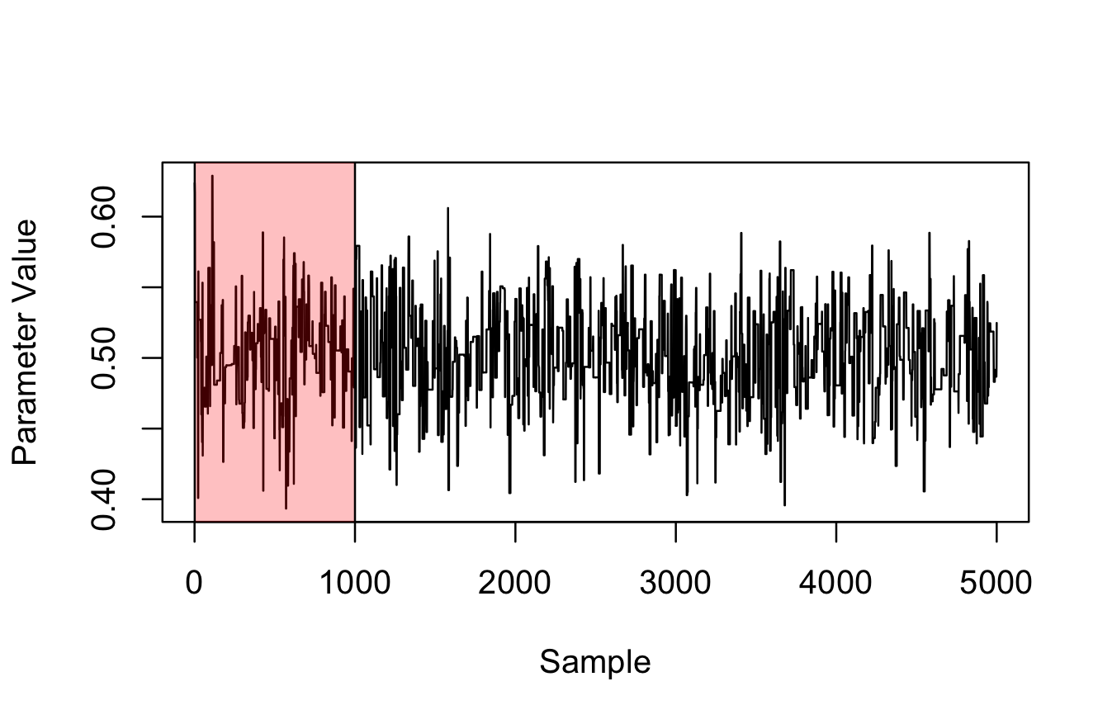
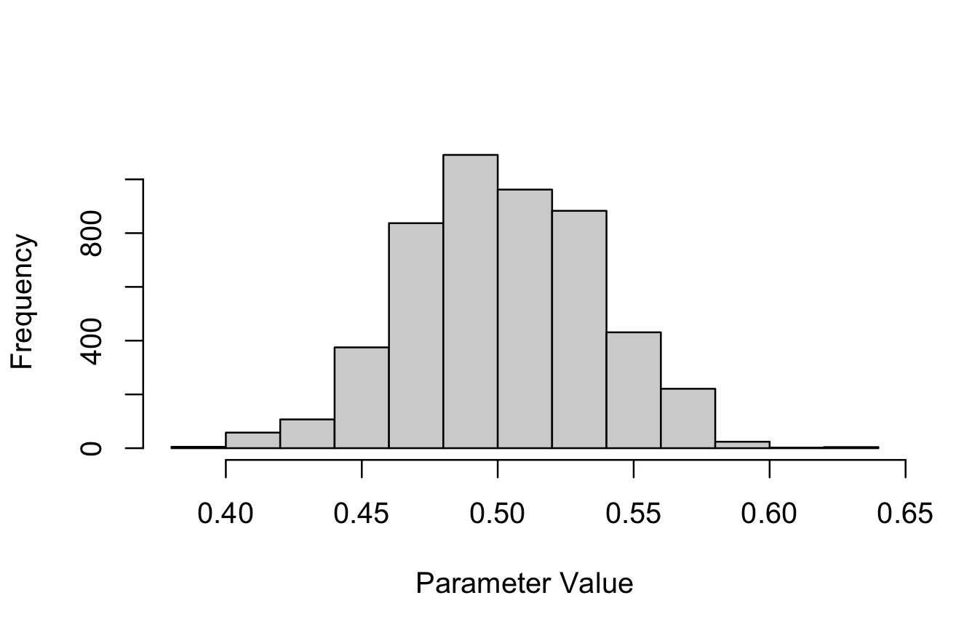
Quick digression about MCMC sampling
We discard the starting values
This distribution is our posterior

Slide 40
2: Fit basic HDDM
“Samples” from the posterior (dbname and db save these samples to a file for later use)
First value = number of samples (including burn-in)
Second value = number of discard samples (burn-in)

Slide 41
2: Fit basic HDDM
Saves the model to a file

Slide 42
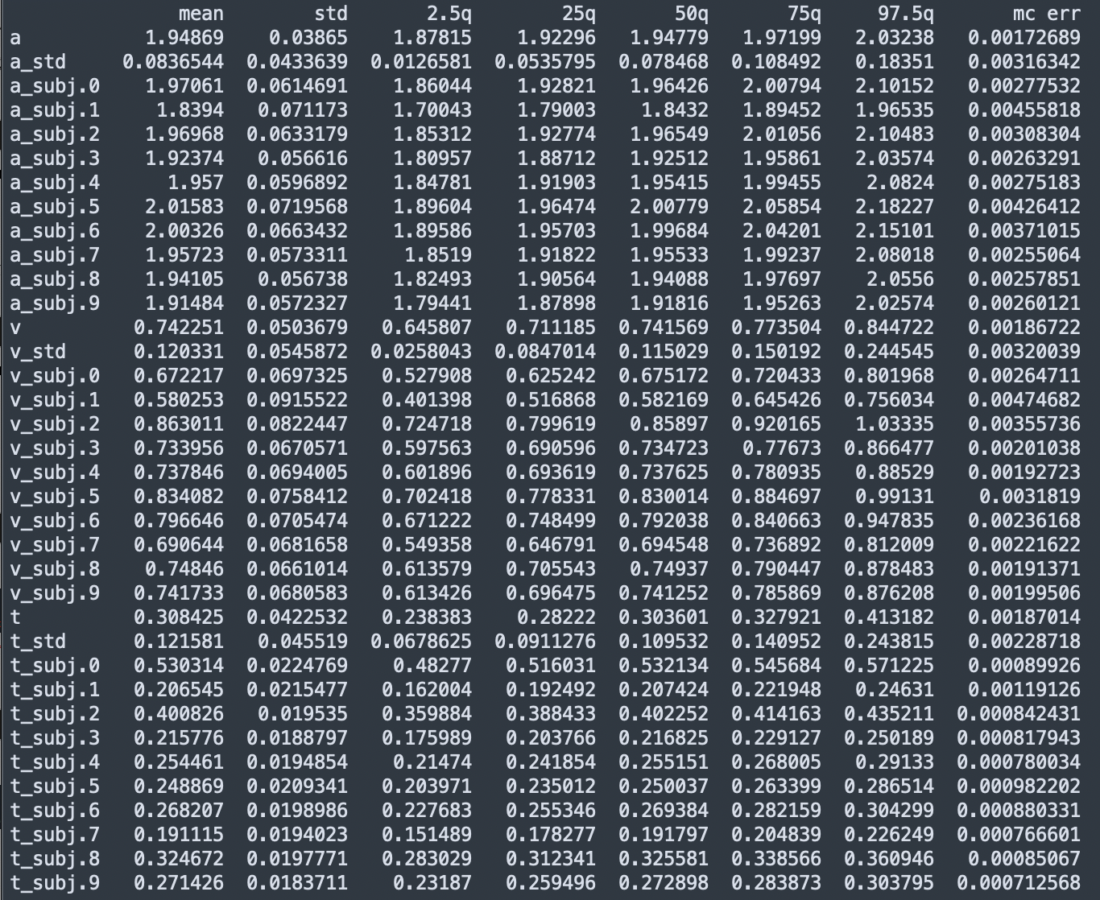
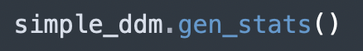
2a. Analyze results
Generates a summary statistics table of the posterior

Slide 43
2a. Analyze results
Group-level decision boundary
Mean of the posterior
SD of the posterior
Quantiles of the posterior
MC error (~ > 1% of posterior SD)

Slide 44
2a. Analyze results
Subject-level posteriors for decision boundary

Slide 45
2a. Analyze results
Same for drift rate

Slide 46
2a. Analyze results
And non-decision time

Slide 47
2a. Analyze results
Bias (z) is not estimated automatically.
Default assumption is non-biased choice (z = a/2)
If you’re dealing with accuracy data, probably best to keep it this way
If you’re dealing with choices, you can model this by setting bias=True in hddm.HDDM()

Slide 48
2b. Visualize results
The raw samples can be extracted with this command + the .trace() command
These values can then be plotted as you see fit

Slide 49
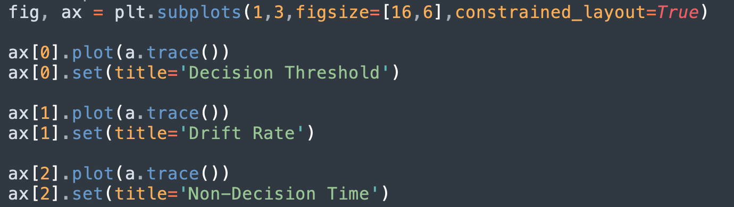
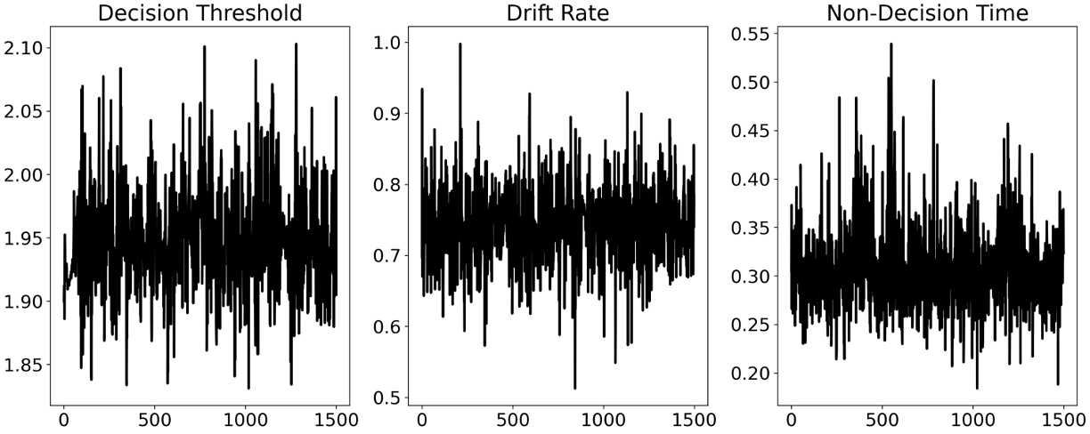
2b. Visualize results
“Should look like fuzzy caterpillars”

Slide 50
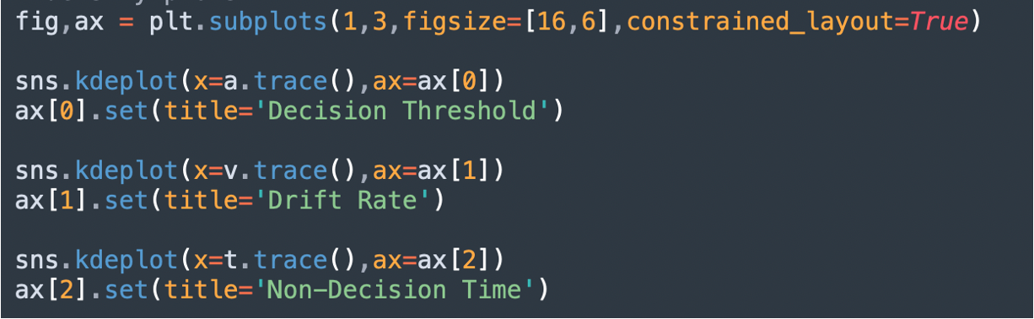
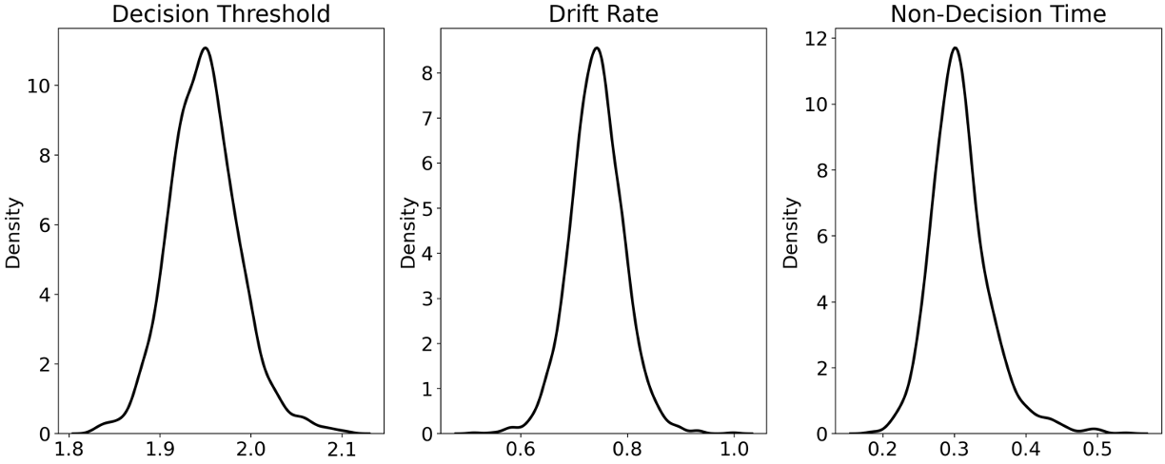
2b. Visualize results

Slide 51
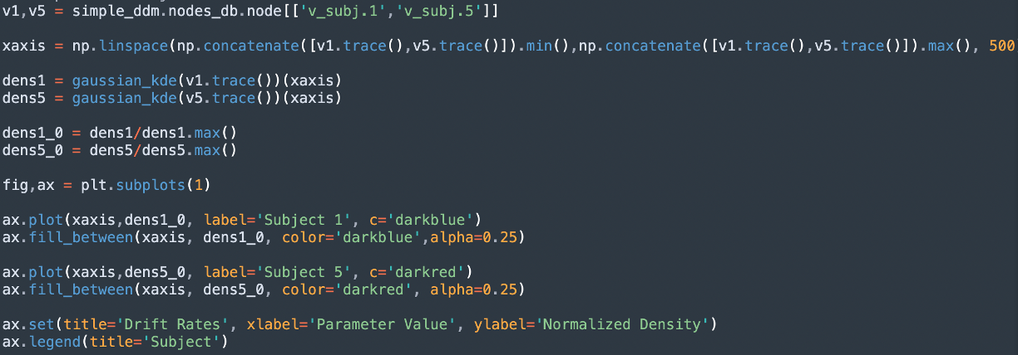
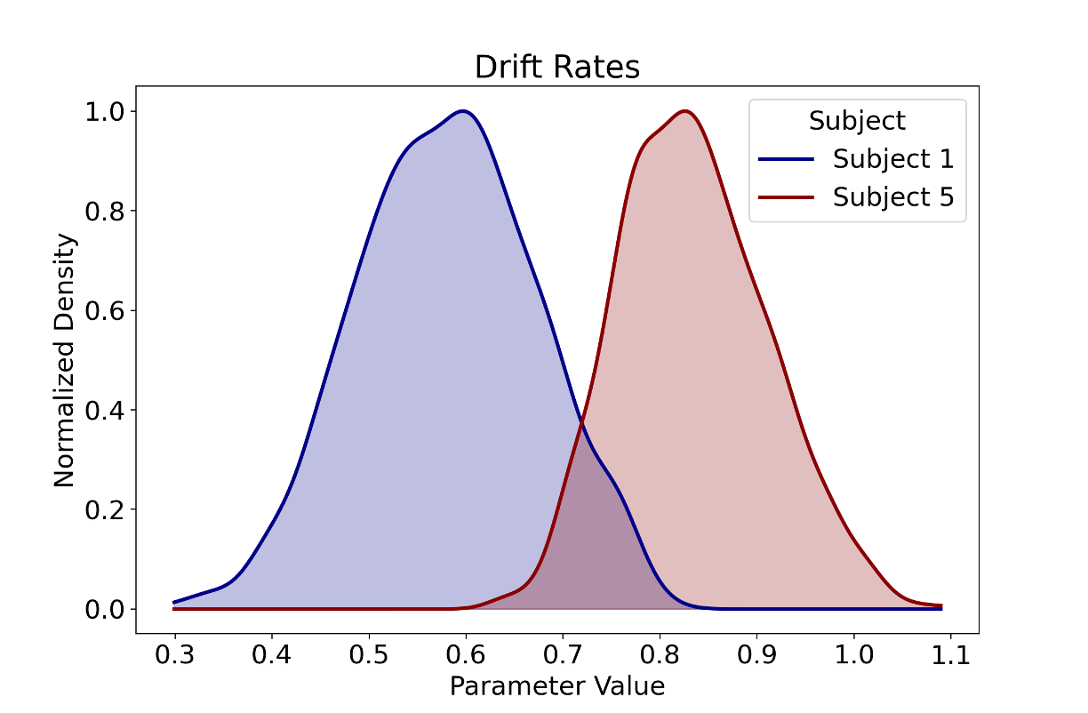
2b. Visualize results

Slide 52
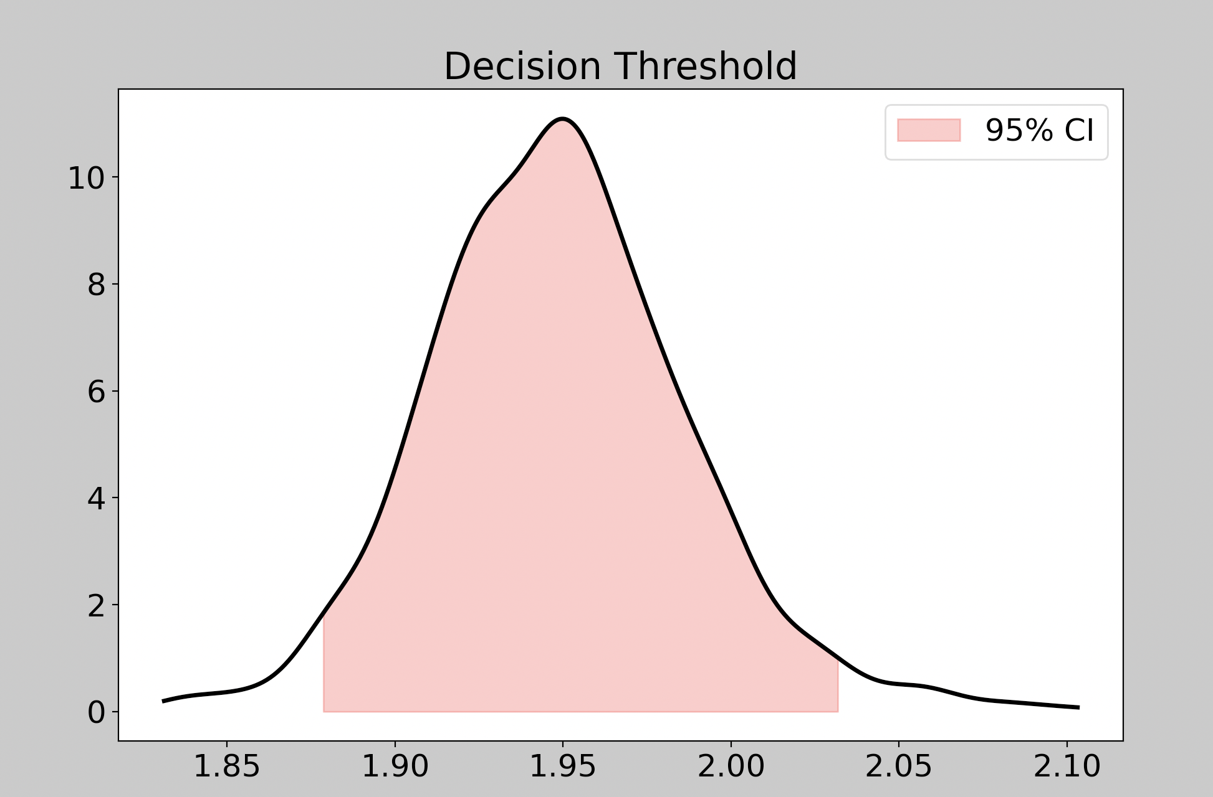
2c. Bayesian statistics
The beauty of a posterior is that we can make very clear inferences about the value of a parameter
You can treat the posterior as you would a population distribution in frequentist statistics
“There is a 95% chance that the decision boundary is between 1.88 and 2.03”.

Slide 53
3. Fit a conditional HDDM
Now we know how to get parameter estimates from HDDM
But sometimes we don’t just want a global parameter estimate, we want to estimate parameters per group
HC and PD in our example
This is very simple with HDDM

Slide 54
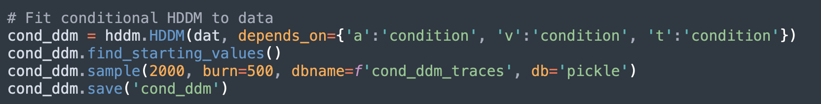
3. Fit a conditional HDDM

Slide 55
3. Fit a conditional HDDM
Condition = {HC, PD}
We pass our data to the same hddm.HDDM() function, but now we include a depends_on argument which takes a dictionary saying which parameters depend on which variable in the dataframe.
Here, we are saying that we want to estimate two different posteriors for each patient condition
So we will end up with a group-level estimated decision boundary, drift rate, and non-decision time per condition

Slide 56
3. Fit a conditional HDDM
Condition = {HC, PD}
All this is the same as before

Slide 57
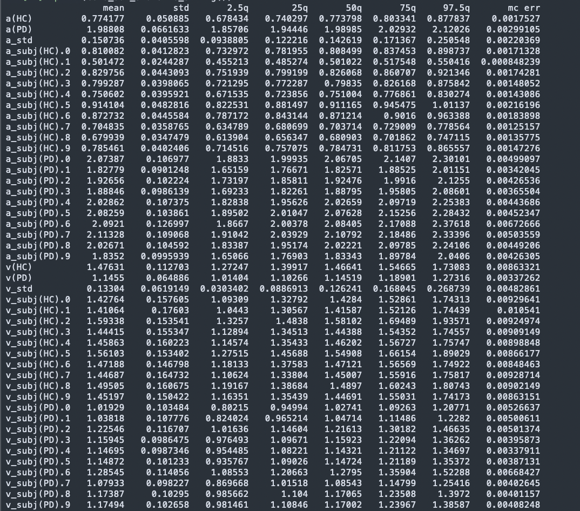
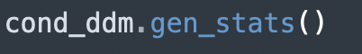
3a. Analyze results

Slide 58
3a. Analyze results
Same columns as before, but now we have a posterior for each patient condition (and still per subject)
t(HC) and t(PD) down here..

Slide 59
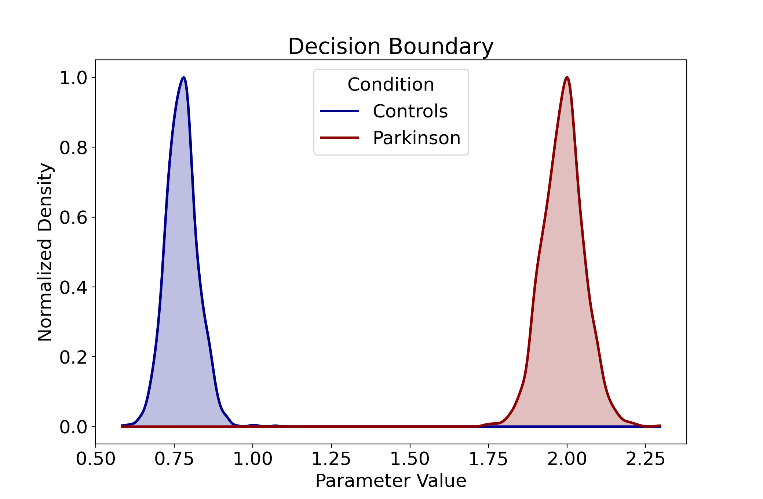
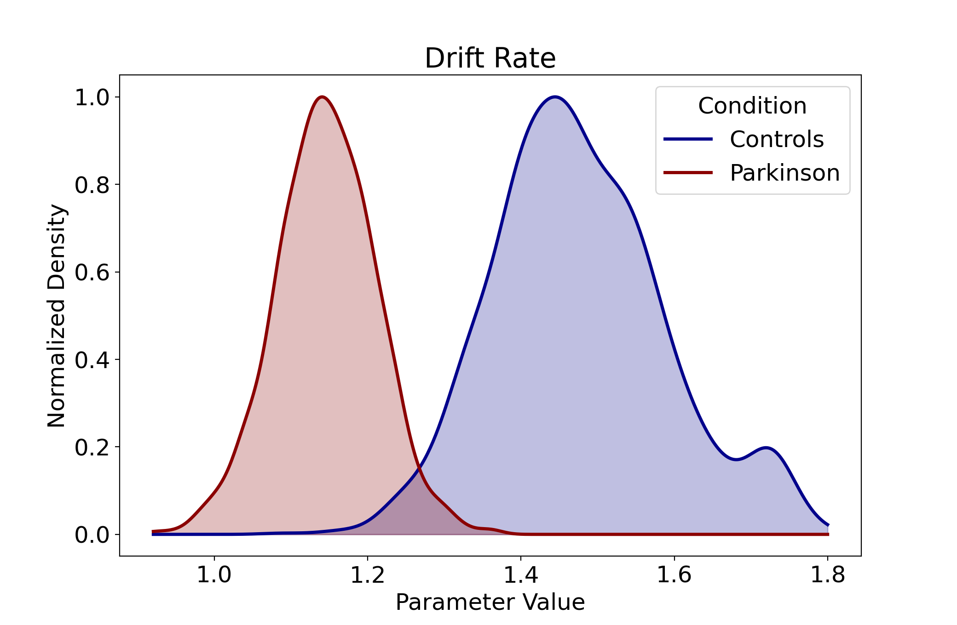
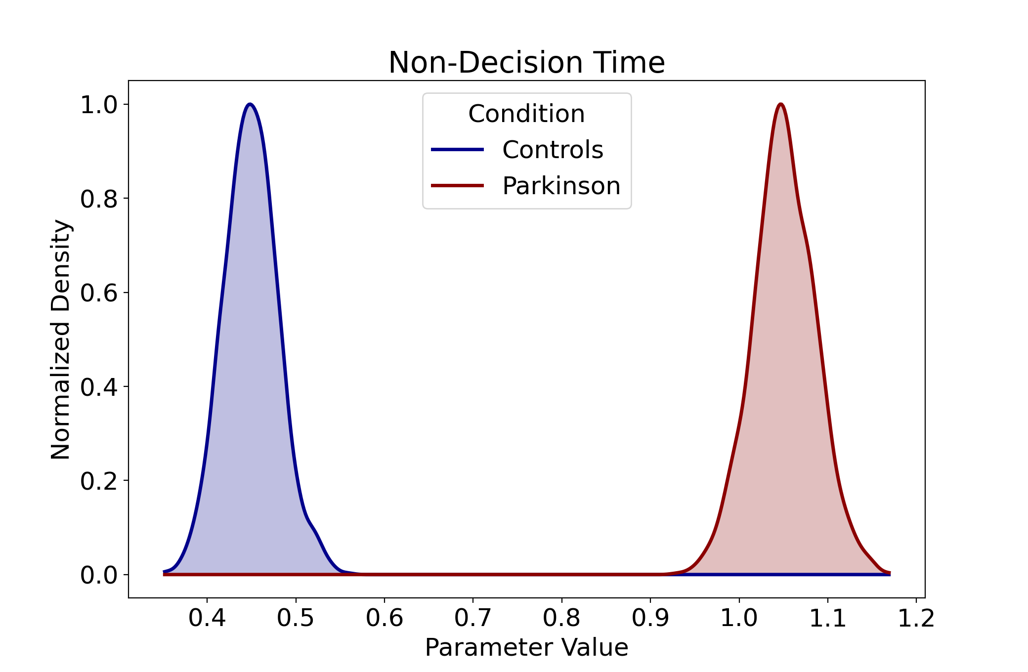
3b. Visualize results
We could plot these posteriors against each other
(see previous slide for code)

Slide 60
3c. Bayesian Statistics
To compare these posteriors we can compute a “Bayesian p-value”, which indexes the probability that the two groups are actually the same in terms of their parameter values.
This is simply the proportion of the posterior where PD > HC, for example.

Slide 61
3c. Bayesian Statistics

Slide 62
3c. Bayesian Statistics
Extract the posterior nodes from the model

Slide 63
3c. Bayesian Statistics
Compute the proportion of cases there HC have lower drift rates than PD patients.
Note: vHC.trace() < vPD.trace() will return a vector of 0s and 1s ([0,0,0,0,1,0…]), which is why the mean equals the proportion of cases

Slide 64
3c. Bayesian Statistics
Here, P = 0.006666666666666667
In words:
“HC exhibited a stronger preference to choosing the option on the right than did PD patients, as reflected in a robust difference in drift rates (Mean HC = 1.48, Mean PD = 1.14, P = 0.007)”.

Slide 65
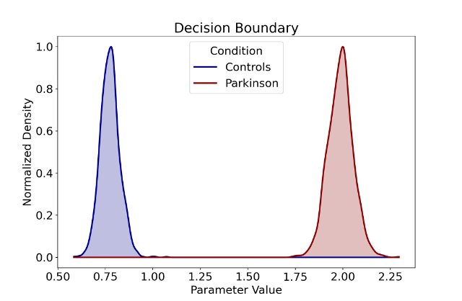
3c. Bayesian Statistics
Here, P = 0
In words:
“HC required more evidence before making a decision, as reflected in a robust difference in decision thresholds (Mean HC = 0.77, Mean PD = 1.99, P = 0)”.

Slide 66
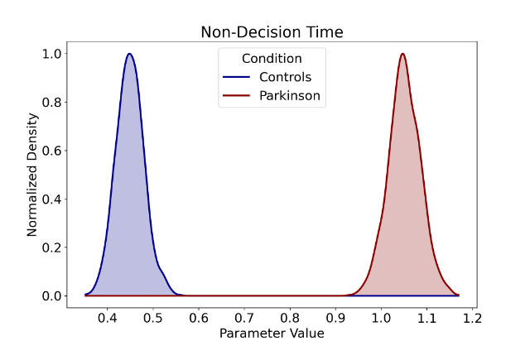
3c. Bayesian Statistics
Here, P = 0
In words:
“PD patients exhibited robust motor slowing compared to HC, as reflected in non-decision times (Mean HC = 0.45, Mean PD = 1.05, P = 0)”.

Slide 67
4. HDDM Regression
A conditional HDDM will work well if you are only interested in group differences.
But sometimes it is desirable to predict a latent parameter (a, v, t) from a continuous observed variable in the dataset.
For instance, here we have a trial-by-trial EEG signal. It may be of interest to predict how increases in EEG signals affect drift rate specifically, holding decision boundaries and non-decision times constant.

Slide 68
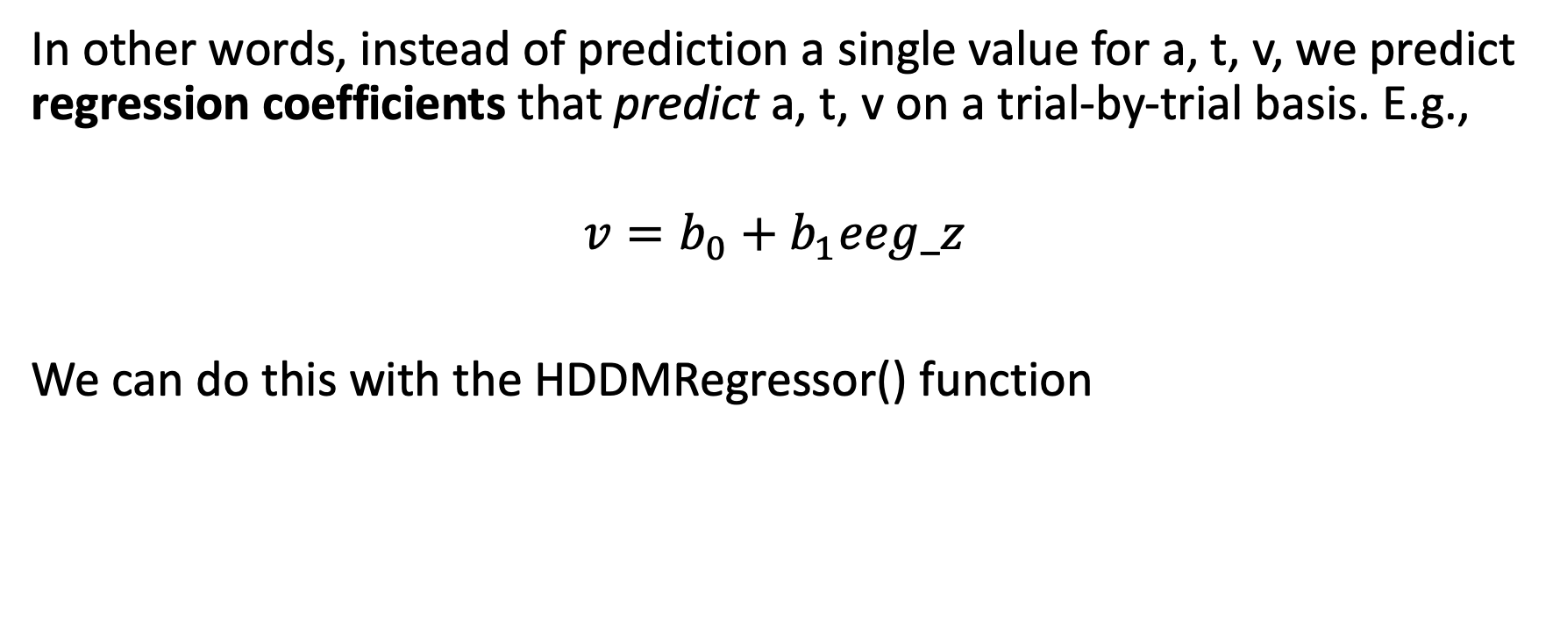
4. HDDM Regression
In other words, instead of prediction a single value for a, t, v, we predict regression coefficients that predict a, t, v on a trial-by-trial basis. E.g.,
$$v=b_{0}+b_{1}eeg_z$$
We can do this with the HDDMRegressor() function

Slide 69
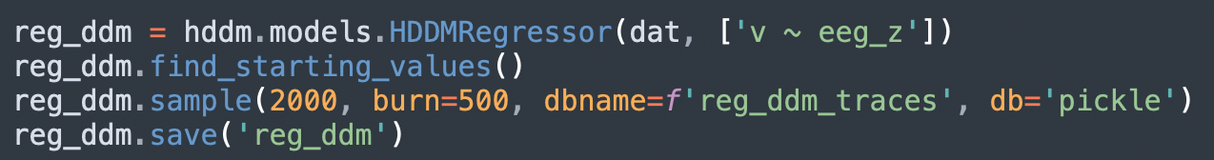
4. HDDM Regression

Slide 70
4. HDDM Regression
Instead of hddm.HDDM(), we now use hddm.models.HDDMRegressor()
We provide it with our data and a list of strings specifying the regression equation
HDDM uses Patsy* under the hood, which has the same format as R regressions:
DV ~ predictor1 + predictor2, etc., where the intercept is implied
* https://patsy.readthedocs.io/en/latest/

Slide 71
4. HDDM Regression
We can pass many regression models to the same HDDM call. E.g.,
[‘a ~ eeg_z, v ~ eeg_z, t ~ eeg_z]
would fit a regression to predict all parameters in the DDM
For now, we will only estimate the drift rate (v) as a function of (~) EEG signal (eeg_z)

Slide 72
4. HDDM Regression
All this is the same as before

Slide 73
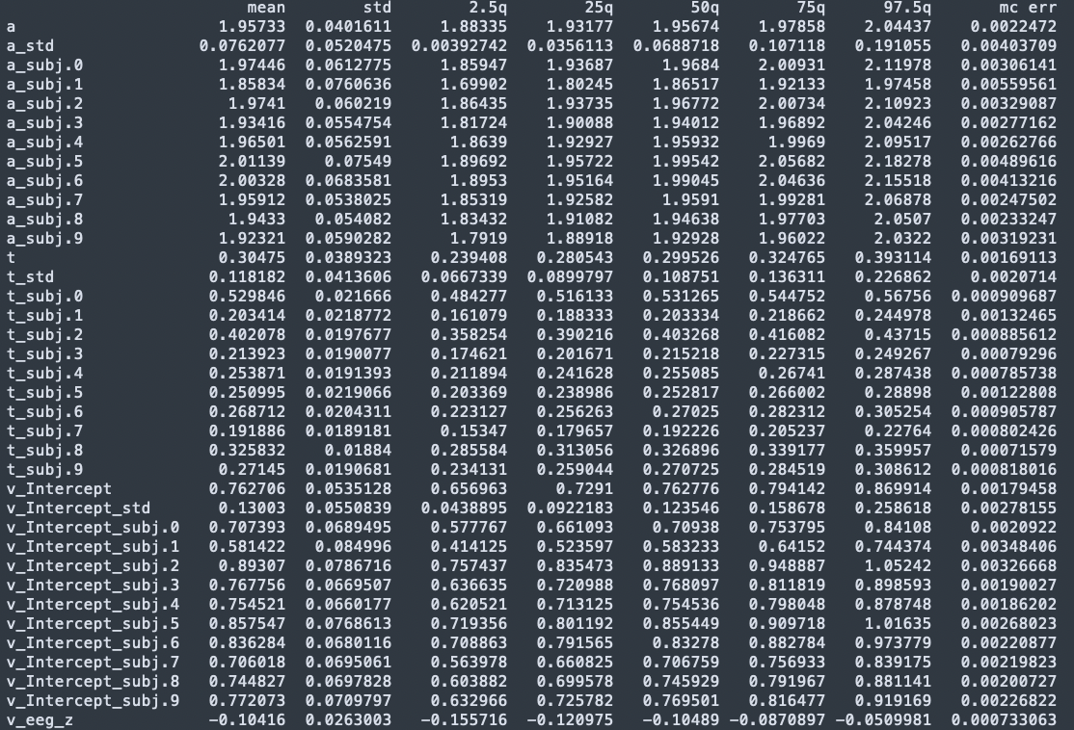
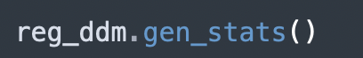
4a. Analyze the results

Slide 74
4a. Analyze the results
Because we did not estimate regression models for a or t, all this output is the same.
That is, group and subject-specific parameter values

Slide 75
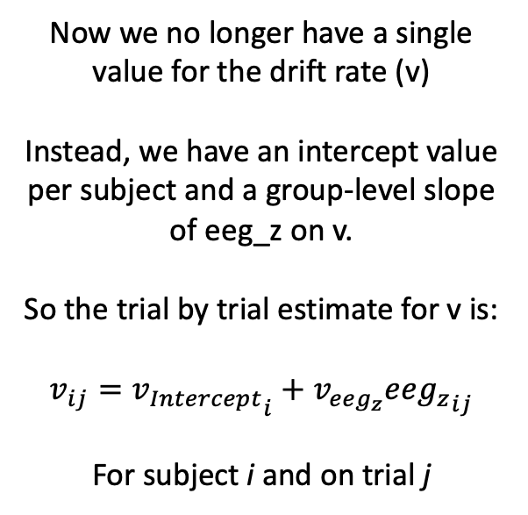
4a. Analyze the results
Now we no longer have a single value for the drift rate (v)
Instead, we have an intercept value per subject and a group-level slope of eeg_z on v.
So the trial by trial estimate for v is:
$$v_{ij}={v_{Intercept}}_{i}+v_{eeg_{z}}ee{g_{z}}_{ij}$$
For subject i and on trial j

Slide 76
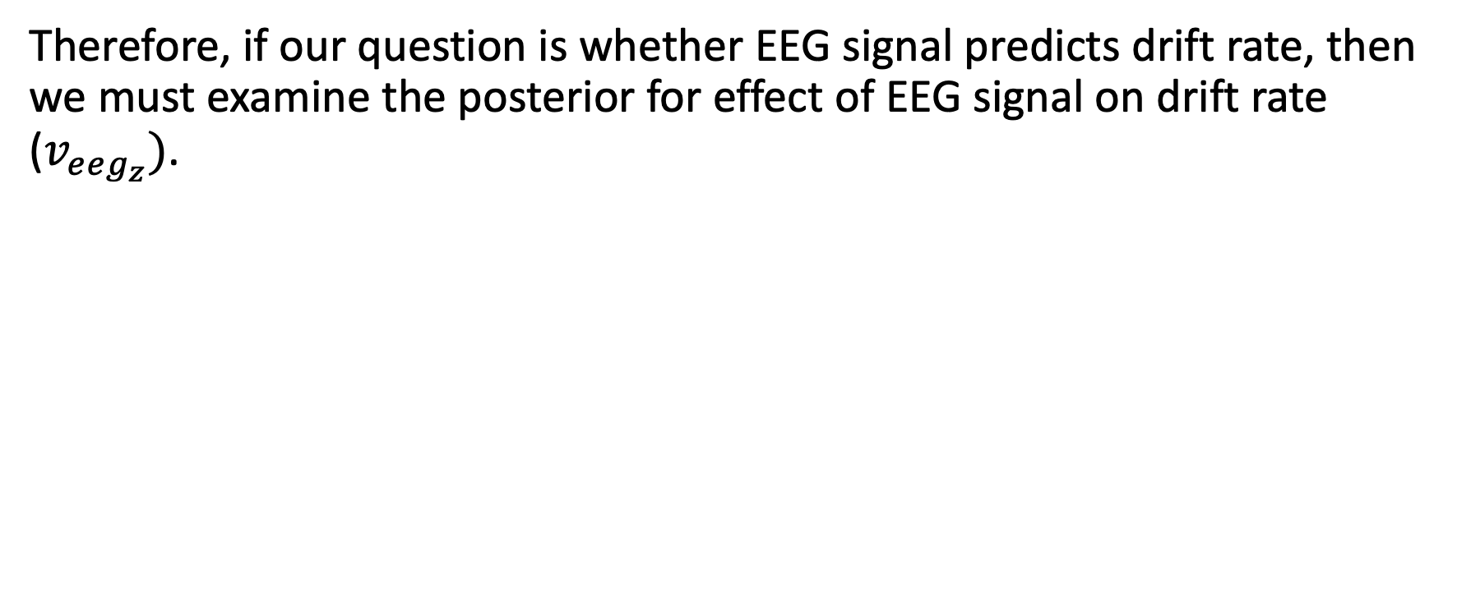
4b. Analyze/Visualize the results
Therefore, if our question is whether EEG signal predicts drift rate, then we must examine the posterior for effect of EEG signal on drift rate ($v_{eeg_{z}})$.

Slide 77
4b. Analyze/Visualize the results
Therefore, if our question is whether EEG signal predicts drift rate, then we must examine the posterior for effect of EEG signal on drift rate ($v_{eeg_{z}})$.
What proportion of the posterior is above 0?
In other words, how likely is it that the effect of EEG on drift rate is bigger than 0?

Slide 78
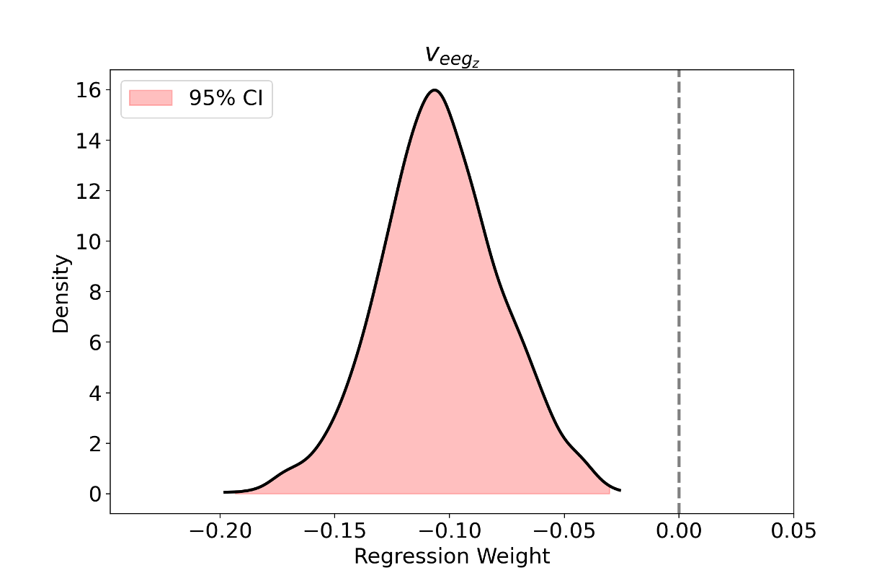
4b. Analyze/Visualize the results
Therefore, if our question is whether EEG signal predicts drift rate, then we must examine the posterior for effect of EEG signal on drift rate ($v_{eeg_{z}})$.
What proportion of the posterior is above 0?
We can compute this directly as we saw before
In other words, how likely is it that the effect of EEG on drift rate is bigger than 0?
In line with the frequentist method, we can see whether this likelihood is less than 5% by specifying 95% CI. If these don’t overlap with 0, the effect is “robust”, ”meaningful”, “”””significant”””””

Slide 79
4b. Analyze/Visualize the results
Therefore, if our question is whether EEG signal predicts drift rate, then we must examine the posterior for effect of EEG signal on drift rate ($v_{eeg_{z}})$.
What proportion of the posterior is above 0?
P(v_eeg_z > 0) = 0
In other words, how likely is it that the effect of EEG on drift rate is bigger than 0?
95% CI = [-0.19 -0.03]

Slide 80
4b. Analyze/Visualize the results
Therefore, if our question is whether EEG signal predicts drift rate, then we must examine the posterior for effect of EEG signal on drift rate ($v_{eeg_{z}})$.
In words,
“EEG signal exerted a negative effect on drift rates, such that when EEG activity was heightened, people tended more quickly towards the left option than the right option (b = -0.10, 95% CI = [-0.19, -0.03], P = 0)”

Slide 81

5. HSSM
Recently released descendant of HDDM
Improves many features of HDDM + adds new features and models that are useful for analyzing hierarchical cognitive data
Not a full overview today, but some highlights and connection to what we’ve seen with HDDM

Slide 82
5a. Installing HSSM
Supposedly easier than installing HDDM
Non-M1 chips
With M1 chips
(with anaconda)
conda create -n pyHSSM python=3.11.0
conda activate pyHSSM
pip install hssm
pip install numpy==1.25.0
pip install jaxlib==0.4.1 jax==0.4.1
(with anaconda)
conda create -n pyHSSM python=3.11.0
conda activate pyHSSM
pip install hssm
pip install numpy==1.25.0
pip uninstall jax jaxlib
conda install -c conda-forge jaxlib
conda install -c conda-forge jax
This worked for me, but not guaranteed!

Slide 83
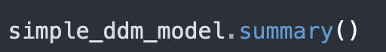
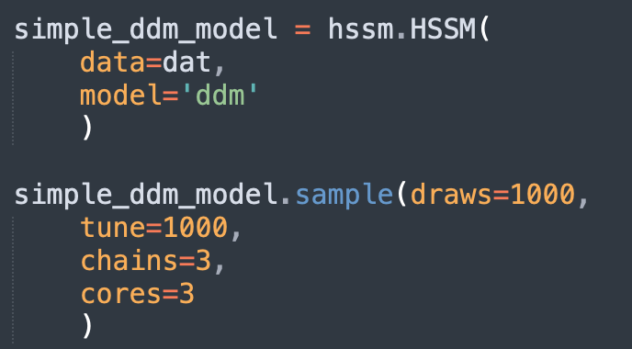
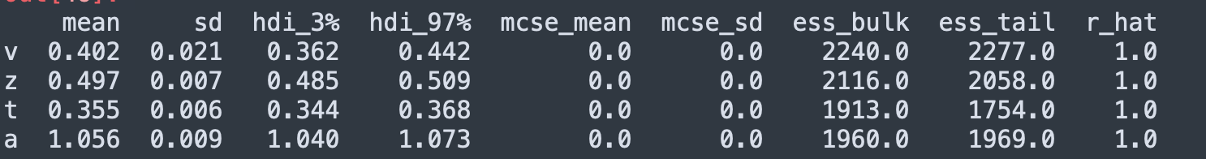
5b. Doing HDDM with HSSM
Basic HDDM
New model diagnostics!
ess_bulk: want to be big (usually > 1000)
ess_tail: similar to ess_bulk
R_hat: want to be as close to 1 as possible (>1.1 is bad)
Differences:
HDDM → HSSM
Specify model as ‘ddm’ (we will see others shortly)
More specific options for sampling procedure

Slide 84
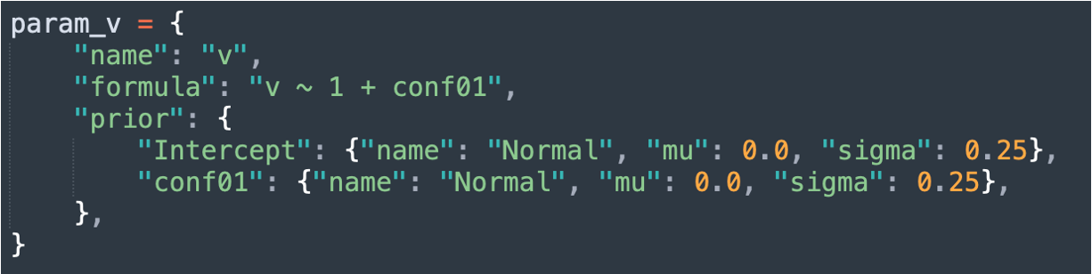
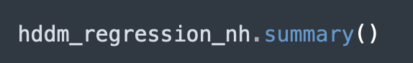
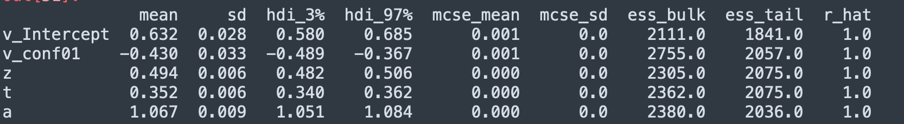
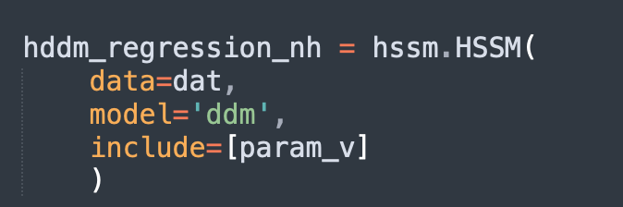
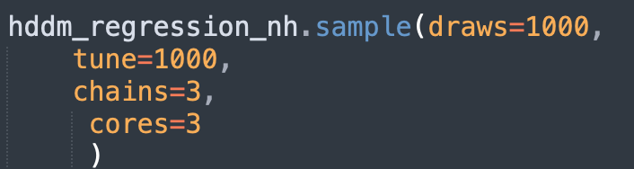
5b. Doing HDDM with HSSM
Conditional HDDM
Conf01 = dummy coded condition variable (0 = HC, 1 = Test)
Differences:
No more “depends_on” argument, must use fixed effects regression approach
Able to specify non-hierarchical regression, basically equivalent to depends_on
Able to specify priors for each coefficient (not necessary)

Slide 85
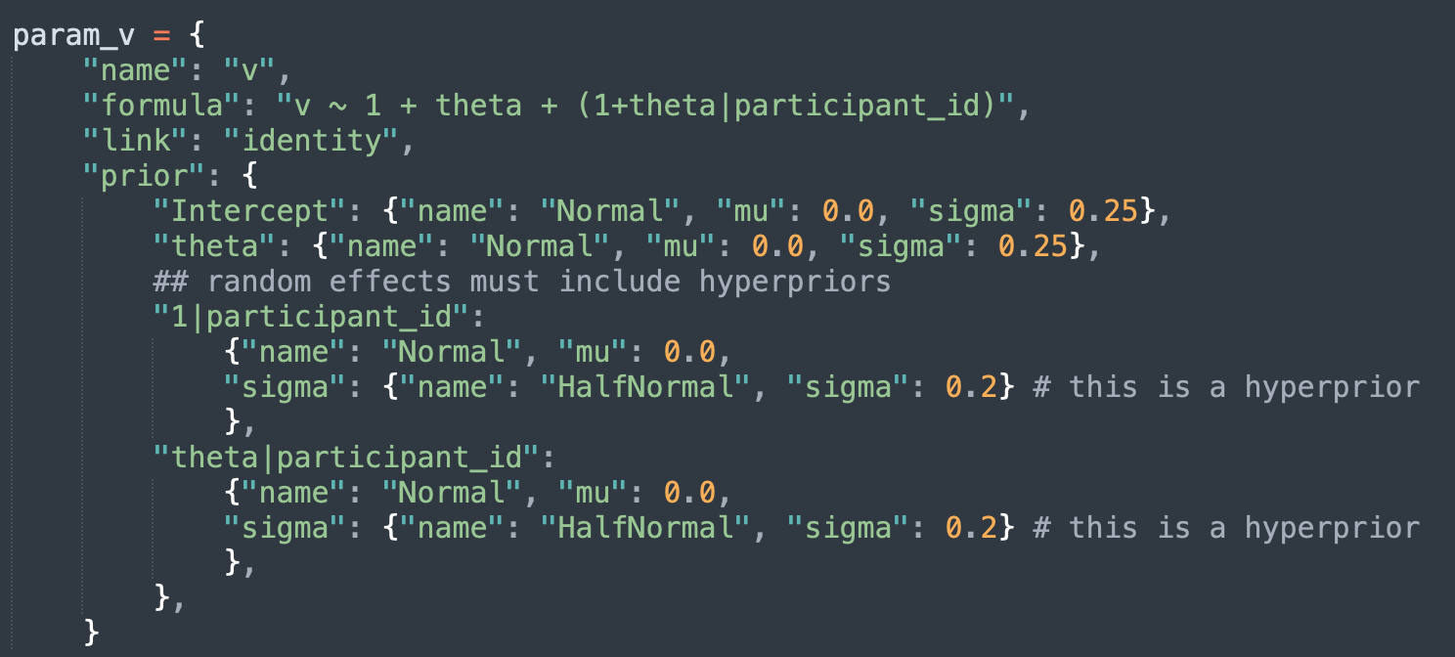
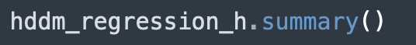
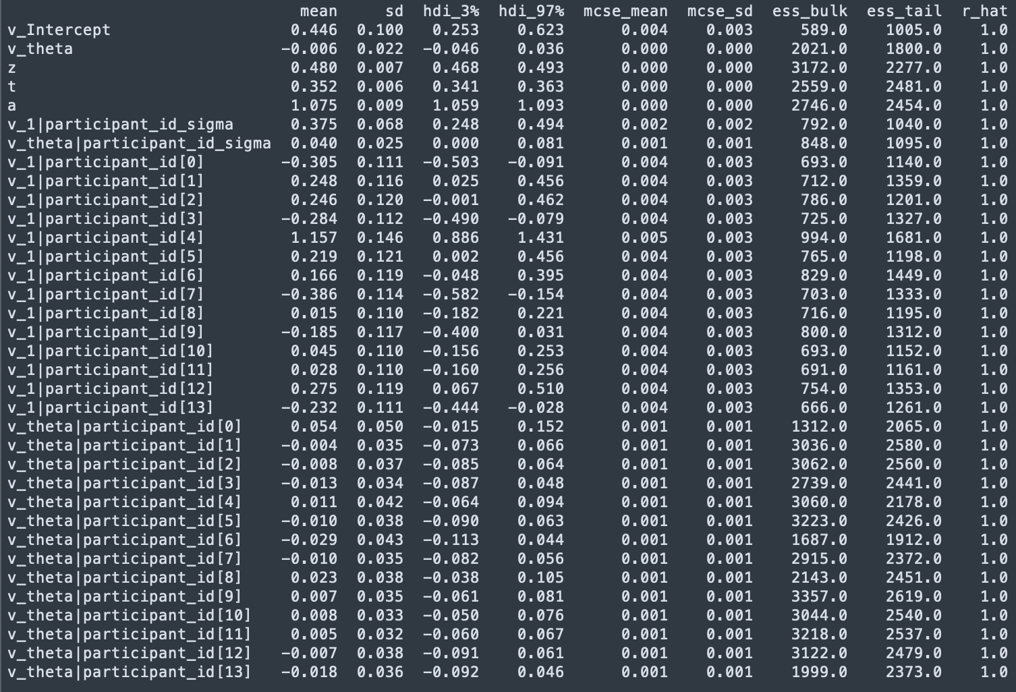
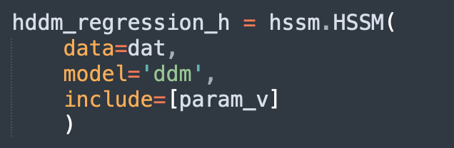
5b. Doing HDDM with HSSM
HDDM Regression
theta = continuous EEG measure (Z-scored)
Differences:
Ability to specify any random effects structure you want
If specifying priors yourself, you need to include hyperpriors for random effects

Slide 86

5c. Novelties with HSSM: New models
Different DDM specifications
The DDM model we’ve seen is not the only one to exist
Other specifications make different assumptions about RT/response tradeoffs
For example, the angle model (aka collapsing bounds)
$$θ$$
t
a
z
v

Slide 87

5c. Novelties with HSSM: New models
Typically, parameters which encode these different assumptions are very difficult to estimate
But with HSSM, it is easy
User note:
With my M1 chip, HSSM → C++ connection for LAN models is glitchy for HSSM v0.2.0
This functionality is also available with HDDM v0.9+, which I know works well

Slide 88



5c. Novelties with HSSM: Built-in visualizations

Slide 89

5c. Novelties with HSSM: Built-in visualizations

Slide 90
Important differences between HSSM and HDDM
HDDM | HSSM
subj_idx | participant_id
response = {0,1} | response = {-1, 1}
Default chains = 1 | Default chains = 4

Slide 91
Advantages of HSSM
Much more flexible than HDDM
Gives user a lot more control
Priors
Random effects structure
Bounds
Model assumptions
Typically, much faster
More built-in visualization features
Easier sampling methods (chains, parallelization, NUTS algorithm, etc.)
Built-in model comparison metrics
Better error messages

Slide 92
Disadvantages of HSSM
Still in development (glitchy on my Mac for some functions)
A little complex unless you know what you are doing
Lots of functionality, but likely more than you need to start
Like HDDM, limited in terms of model comparison functions
Gives you the ability to fit lots of different types of DDM, but how do you know which is best?
Not obvious yet for hierarchical models in general, let alone DDMs (see Devine et al., 2024)

Slide 93
Summary
What we saw
What a DDM is
When to use it
How to use it

Slide 94
Summary
What we did not see
Fit indices
Model simulation
Posterior Predictive Checks
Mixed models (both HDDMRegression and depends_on)
ROPE and Bayes Factors for inference
Model diagnostics
Complex regression structures
Complex LANs with HSSM
And much much more….

Slide 95
Parting advice
Common mistakes:
HDDM cannot handle missing data, so remove all NA from your data
RT > 0 and response ∈ {0,1} (or {-1,1} for HSSM)
RT have to be in seconds, not ms.
HDDM should detect long outliers, but double-check yourself as this can skew estimates and radically increase fitting time

Slide 96
Thanks for listening ☺
For questions and comments:
seandamiandevine@gmail.com

